Slide 1

EdgeSynth: Leveraging AI for Synthetic Edge Data
Student Name: Ehtisham Ali (10467231)
Course: Master Project

Slide 2

Introduction
IoT & Edge devices generate massive data (90+ ZB by 2025)
Cloud-only processing: bandwidth, latency, privacy challenges
Paradox: global data abundance vs. local data scarcity at the edge
Objective: Enable edge AI with synthetic data

Slide 3

Research Problem & Objectives
Problem: Limited real data for edge AI model training
Objectives:
Investigate synthetic data methods for IoT/Edge
Design GPT-2–based generative framework
Evaluate data quality (stats + ML utility)
Package into usable prototype (Streamlit)

Slide 4
Background (Methods)
Generative Models for synthetic data:
GANs (CTGAN, TimeGAN) – strong but unstable
VAEs – easier, less fidelity.
Transformers (LLMs) – stable, interpretable.
Edge constraints: Need lightweight yet realistic generators

Slide 5
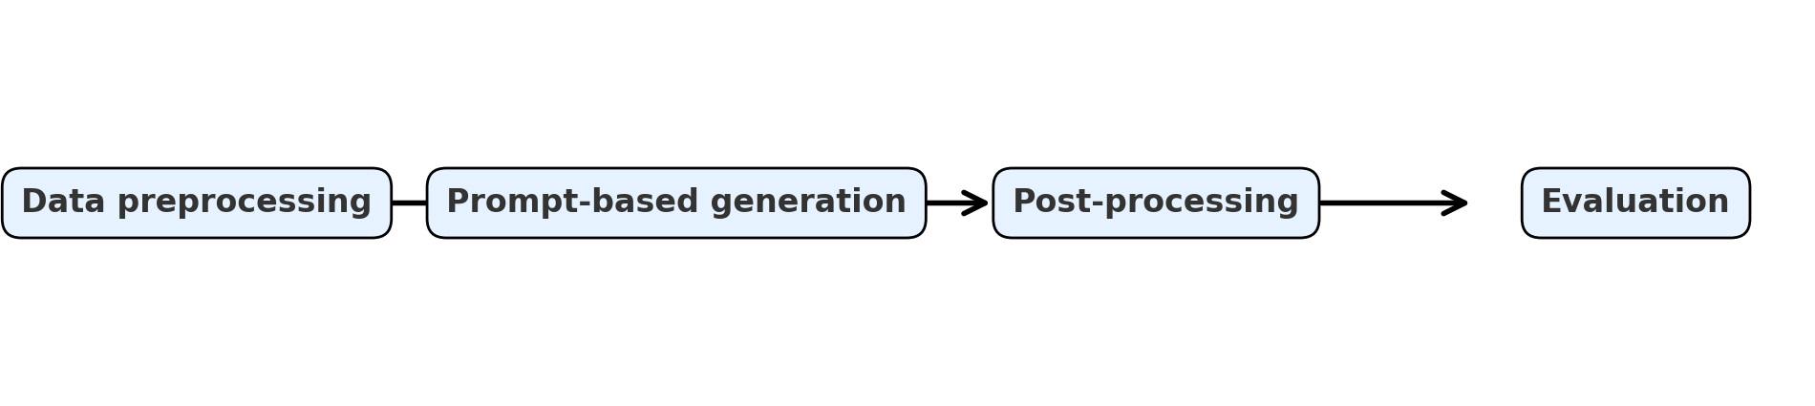
EdgeSynth Framework
Input: Wind Turbine SCADA dataset
GPT-2 small (124M params) + prompt engineering
Pipeline: Data preprocessing → Prompt-based generation → Post-processing → Evaluation
Key features: wind speed, rotor speed, generator speed, temperature, power output.

Slide 6

Methodology Details
Data cleaning: outliers removed, normalization, 80/20 split
Generation: GPT-2, temperature = 0.95, top-p = 0.95, top-k = 100
Post-processing: parsed into tabular form, clipped unrealistic values
Evaluation methods:
KS tests (distribution similarity)
Correlation heatmaps
Regression ML utility (MAE, R²).

Slide 7
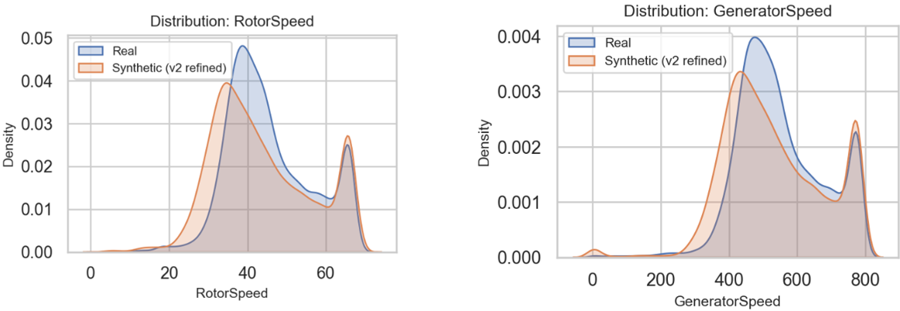
Results (Distribution Fidelity)
Synthetic data distributions closely matched real data
KS test p > 0.3, low KS statistics (0.05–0.09)
Visual KDE plots: WindSpeed, PowerOutput, RotorSpeed, GeneratorSpeed, GeneratorTemperature

Slide 8
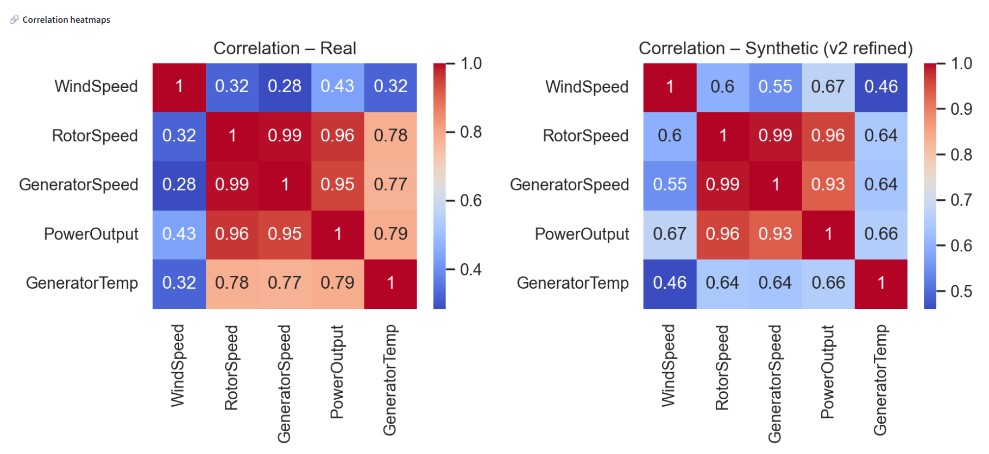
Results (Correlation & Utility)
Correlation structures preserved (Rotor vs. Generator Speed = 0.99 both sets)
Regression (Power prediction):
Real: MAE = 0.04, R² = 1.00
Synthetic: MAE = 0.03, R² = 1.00

Slide 9
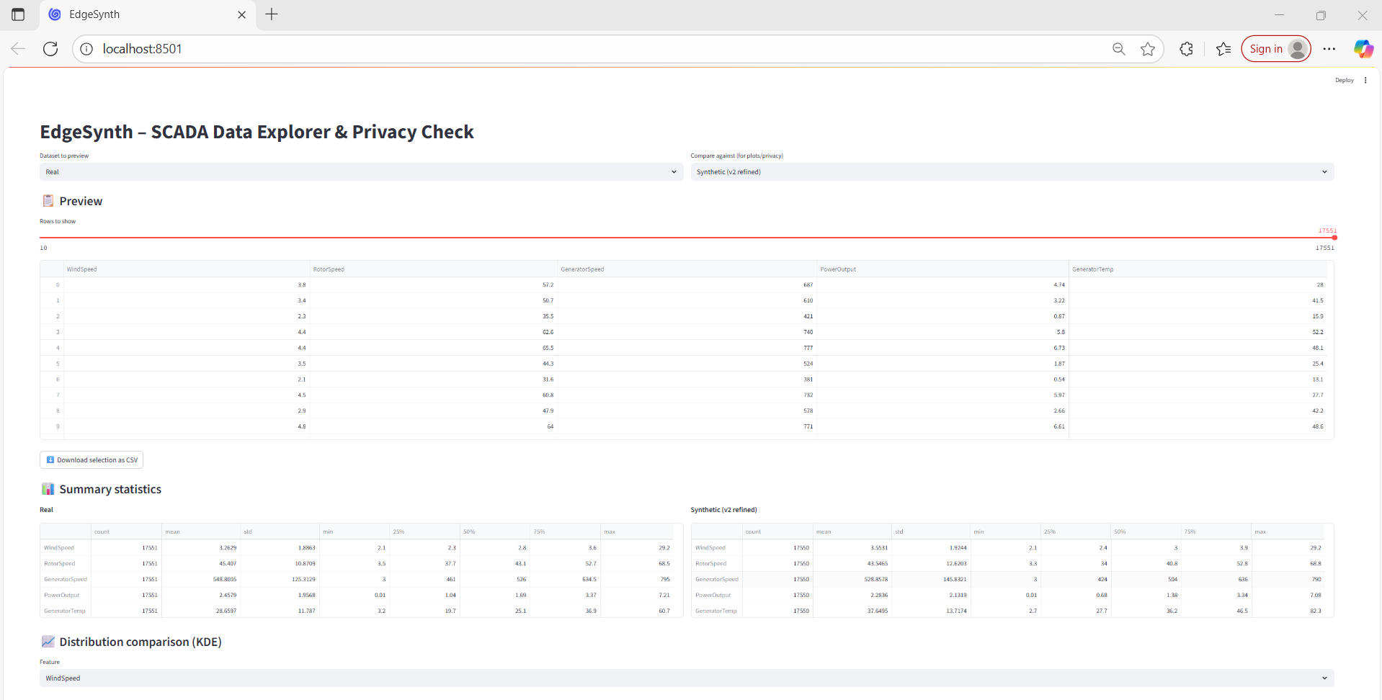
Prototype (Streamlit App)
Features:
Dataset preview & stats
Distribution overlays
Correlation heatmaps
Privacy checks (nearest-neighbor)

Slide 10
Discussion & Contributions
Contributions:
GPT-2 as viable edge data generator
Lightweight → feasible for edge gateways
Preserves fidelity & utility while reducing privacy risks
Implications: synthetic data can augment scarce IoT logs, support federated learning, and reduce cloud reliance.

Slide 11

Limitations and Future Work
No temporal modeling → future: TimeGAN, autoregressive transformers
Limited categorical handling → add CTGAN-like conditioning
Privacy not formally guaranteed → explore DP-CTGAN
Sustainability: quantization & pruning for edge deployment.

Slide 12

Conclusion
EdgeSynth demonstrated realistic, privacy-friendly synthetic SCADA data
Validated across distributions, correlations, and ML tasks
Delivered as both research and interactive tool
Opens path to scalable, robust edge AI.

Slide 13
Questions?
Feel free to ask

